Slide 1

UNIVERSITY BLOG PLATFORM
Menaka Naga Sai Pothina(700772418)
Mandoji Sai Tejaswi(700758342)
Gali Udaya Rekha Chowdari(700774490)
Kadthala Udayasri(700762361)

Slide 2




Introduction:
The University Blog Platform is an online space for university members to discuss, share knowledge, and collaborate on various topics. It is organized into "Rooms," which are customizable spaces where users can talk about academic subjects or personal hobbies. These Rooms cover a wide range of topics, from university courses to extracurricular activities like sports, making it useful for different interests.
A key feature of the platform is the academic Rooms, which focus on specific subjects. These Rooms allow students and teachers to share materials, discuss assignments, and study together. Additionally, the platform includes Sports Rooms where users can talk about sports like football or basketball, share strategies, and discuss team updates.
There are two main roles on the platform: Admins and Owners. Admins manage the entire platform, ensuring it runs smoothly and that rules are followed. They can block or unblock users who break the rules. Owners manage specific Rooms, approving or rejecting members, moderating discussions, and ensuring respectful behavior. Owners can block or unblock posts in their Rooms but cannot block users.

Slide 3
Room Members, who join based on their interests, drive the discussions. They can post text, images, videos, or links, allowing for rich interactions. For example, a student might share a video tutorial or post an academic article in a course Room. There is also a rating system where users can like or dislike posts to highlight valuable contributions.
In summary, the University Blog Platform provides an organized and interactive space for academic and extracurricular discussions. It uses clear roles, easy content-sharing options, and guidelines to encourage teamwork while keeping the community positive and respectful.

Slide 4
Database description:
In this University Blog Platform we have seven collections: admin, room_category, room, room_members, member, polls and post collections.
The admin collection is made to support admin. Such users manage the entire platform, and each admin has a unique admin_id detected through the username and password. These details will be stored in the admin collection.
The room_member will register on the website with his details, like owner_name, email, phone, password, state, city, zip_code and members[ ]. This data will be stored in the room_member collection. After registration, the room_member will be logged into the website with a registered email and password.
The admin can add the room_categories with room_category. This data will be stored in the room_categories collection.
After that the admin will add the rooms based on room categories with details like room_title, description, created_on, created_by, status and by selecting room_member. Here the room_category_id and room_member_ids are the reference keys. This data will be stored in the rooms collection.

Slide 5
The room_member can add and view the list of posts in rooms with details like title, image, video, status, likes[ ], comments[ ] and room_id. Here room_id is the reference key in this post collection. This data will be stored in the posts collection.
The member will register on the website with his details, like first name, last name, email, phone, password, state, city, zip_code.This data will be stored in the member collection. After registration, the member will be logged into the website with a registered email and password.
In the polls collection we have post_id, member_id, room_member_id, question, answers[ ] and submitted_count. Here post_id,member_id,room_member_id are the reference keys. These data will be stored in polls collection.

Slide 6
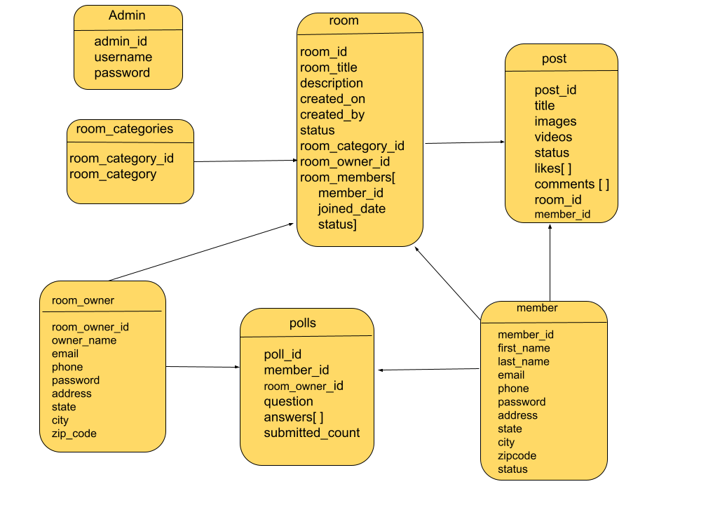
Database model diagram

Slide 7

Home page

Slide 8
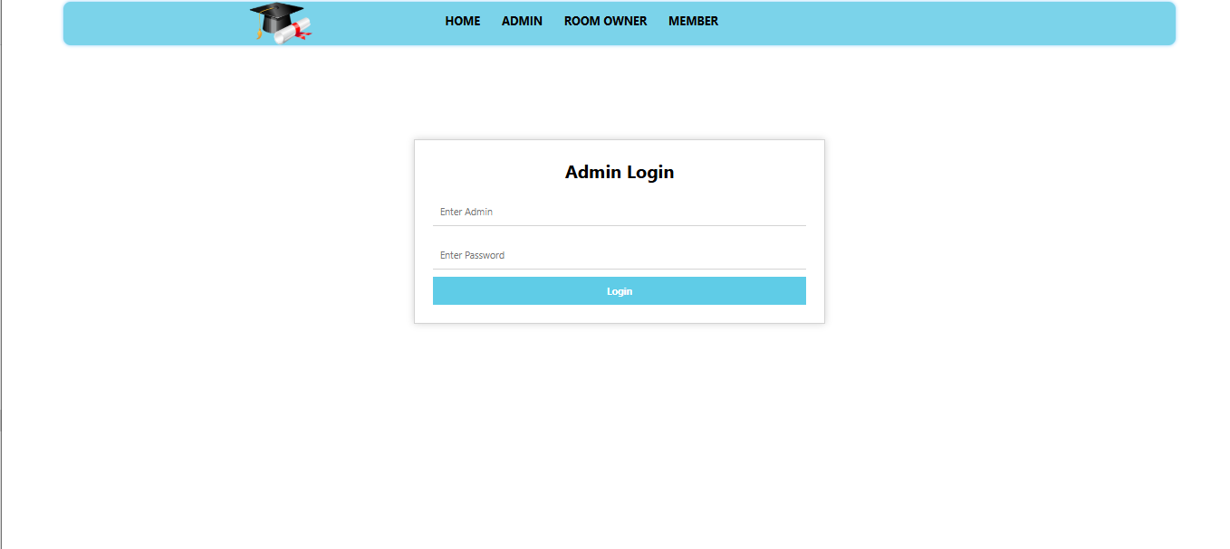
Admin login page

Slide 9
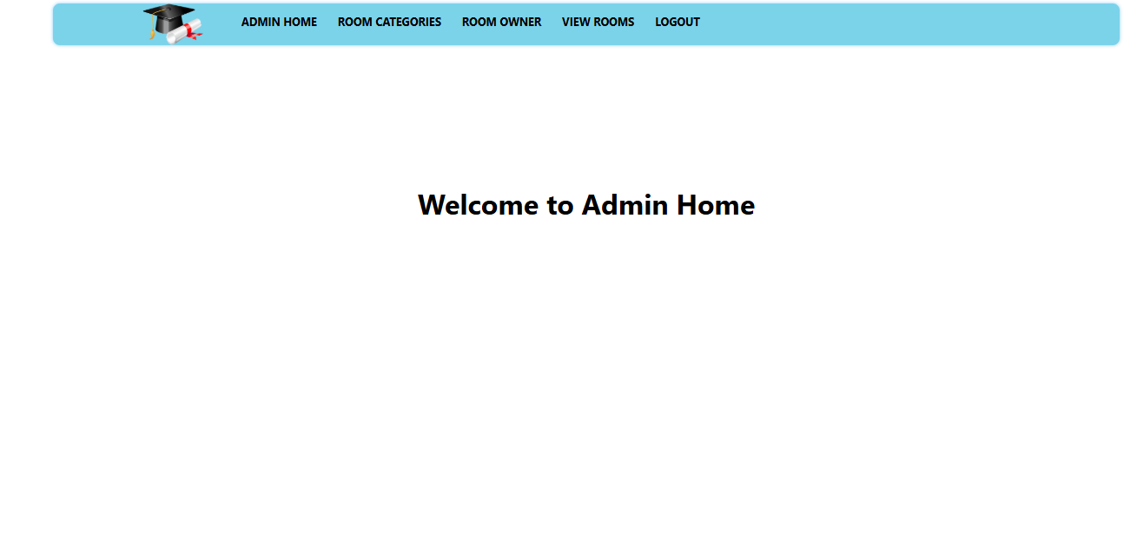
Admin home page

Slide 10
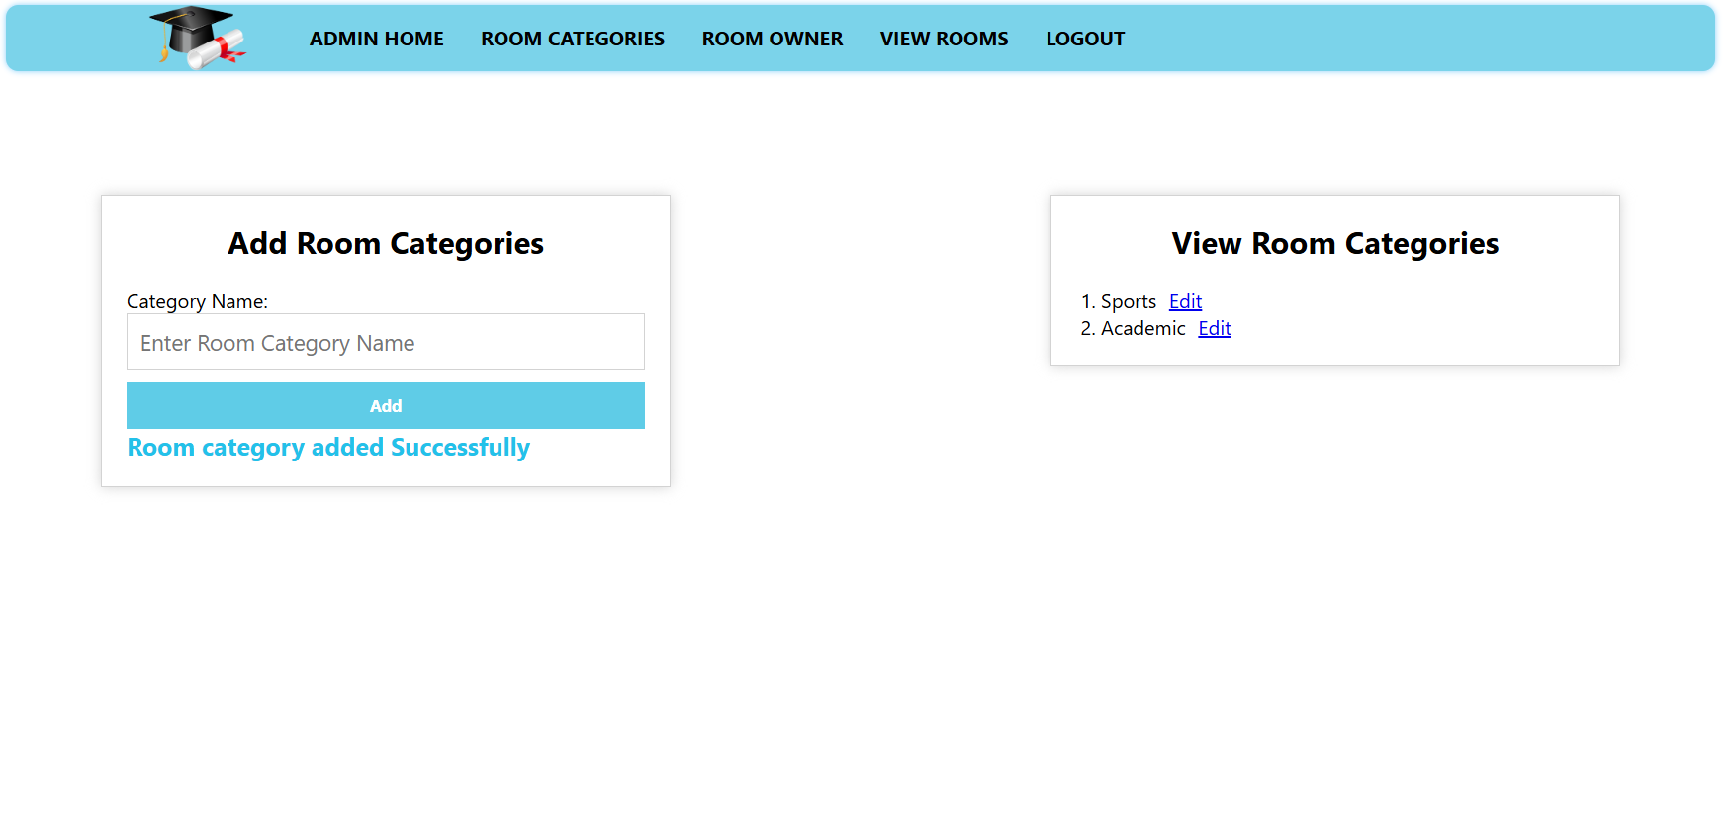
Add room categories
.

Slide 11
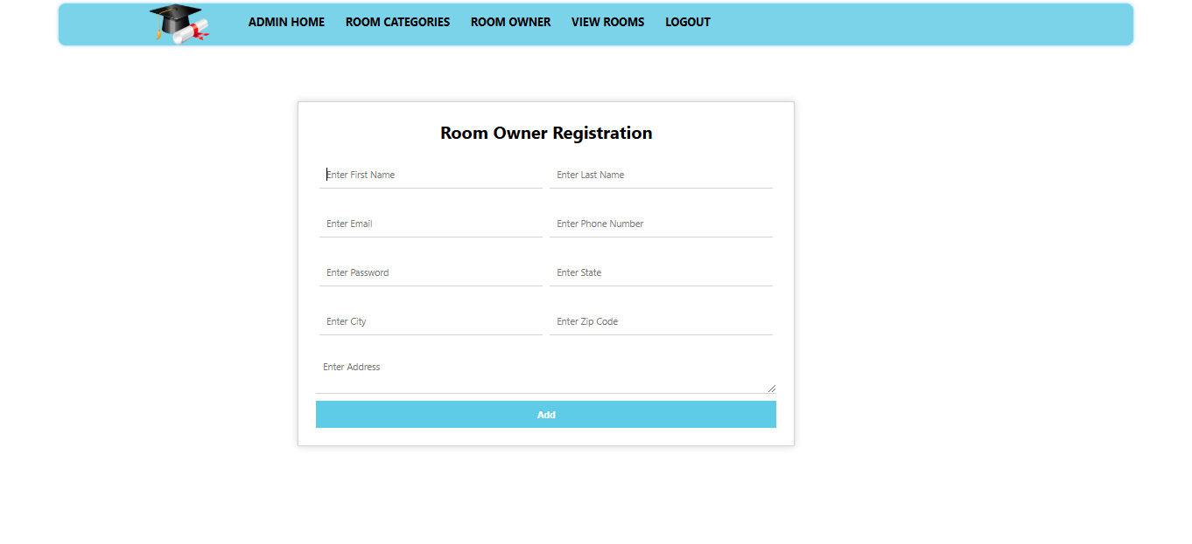
Room owner registration page

Slide 12
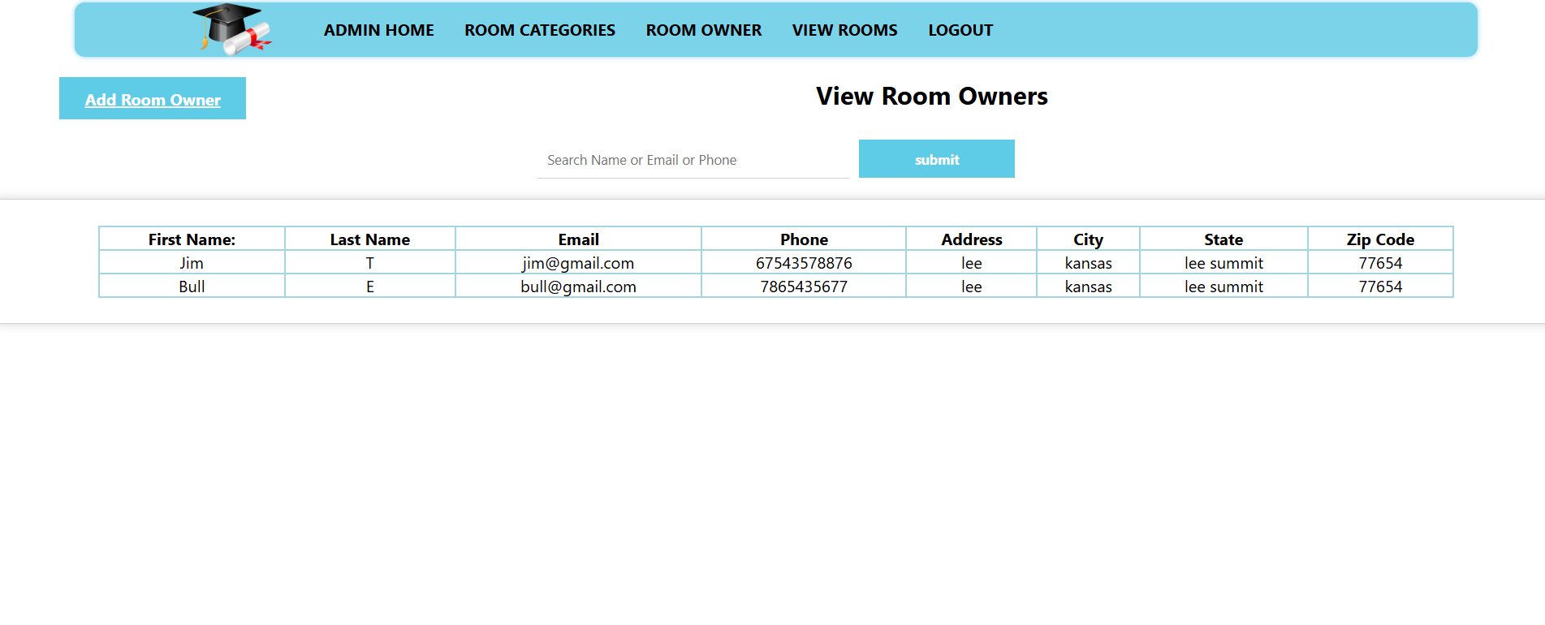
View room owners

Slide 13
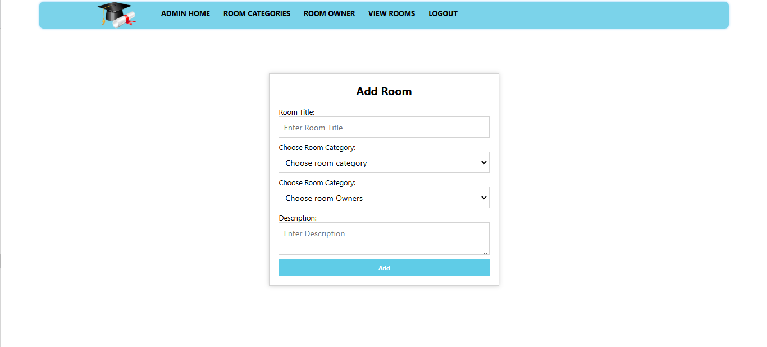
Admin add room owner

Slide 14
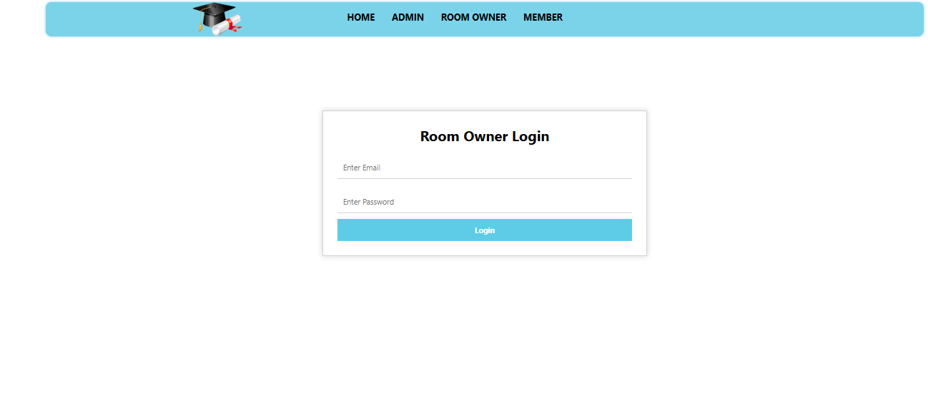
Room owner login page

Slide 15
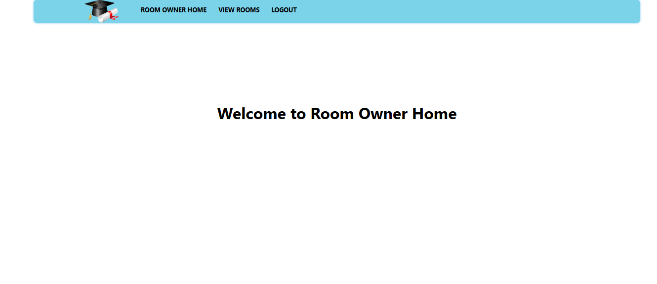
Room owner home page

Slide 16
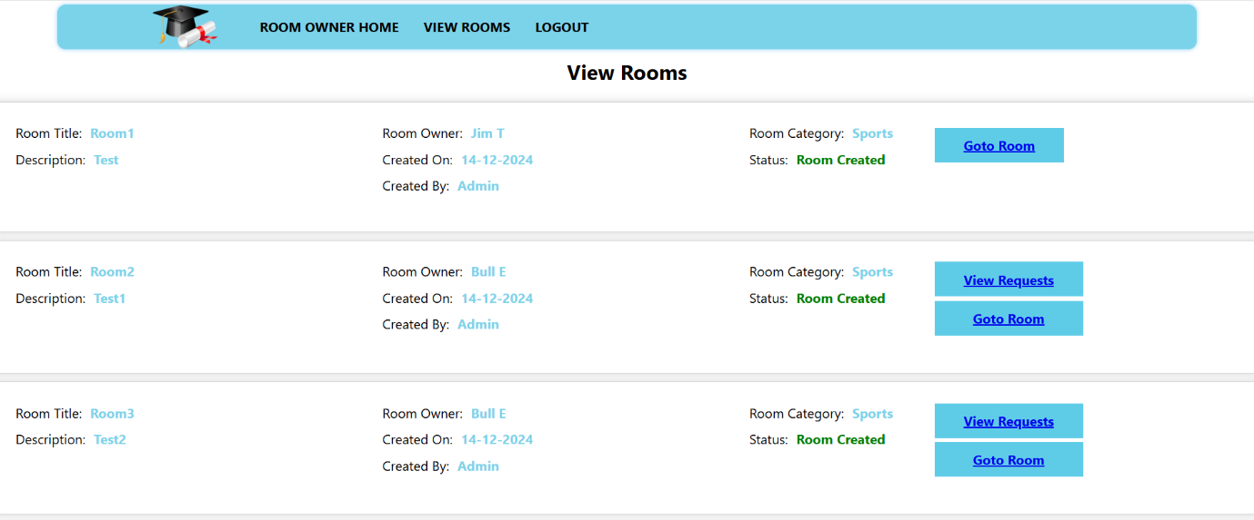
View rooms

Slide 17
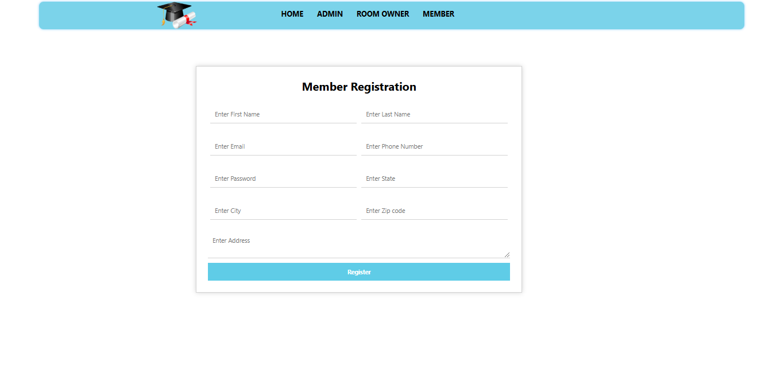
Member registration page

Slide 18
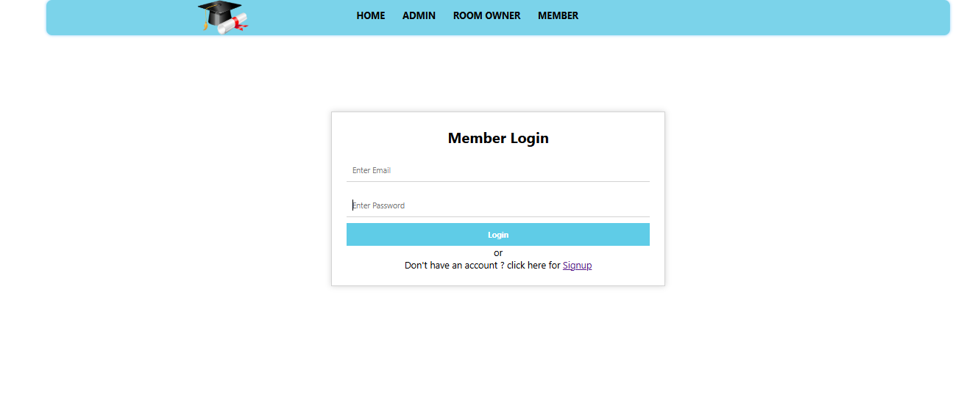
Member login page

Slide 19
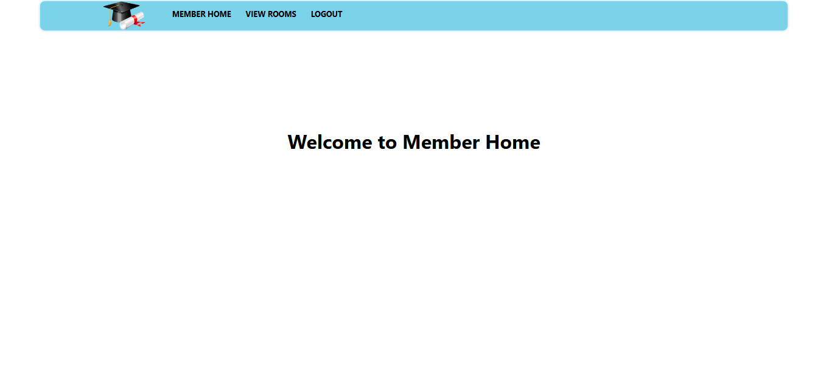
Member home page

Slide 20
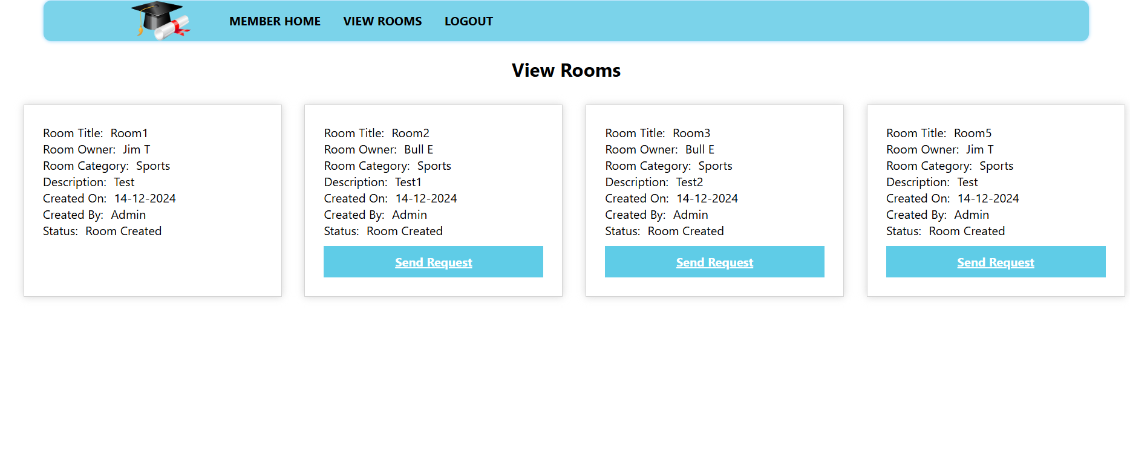
View rooms

Slide 21
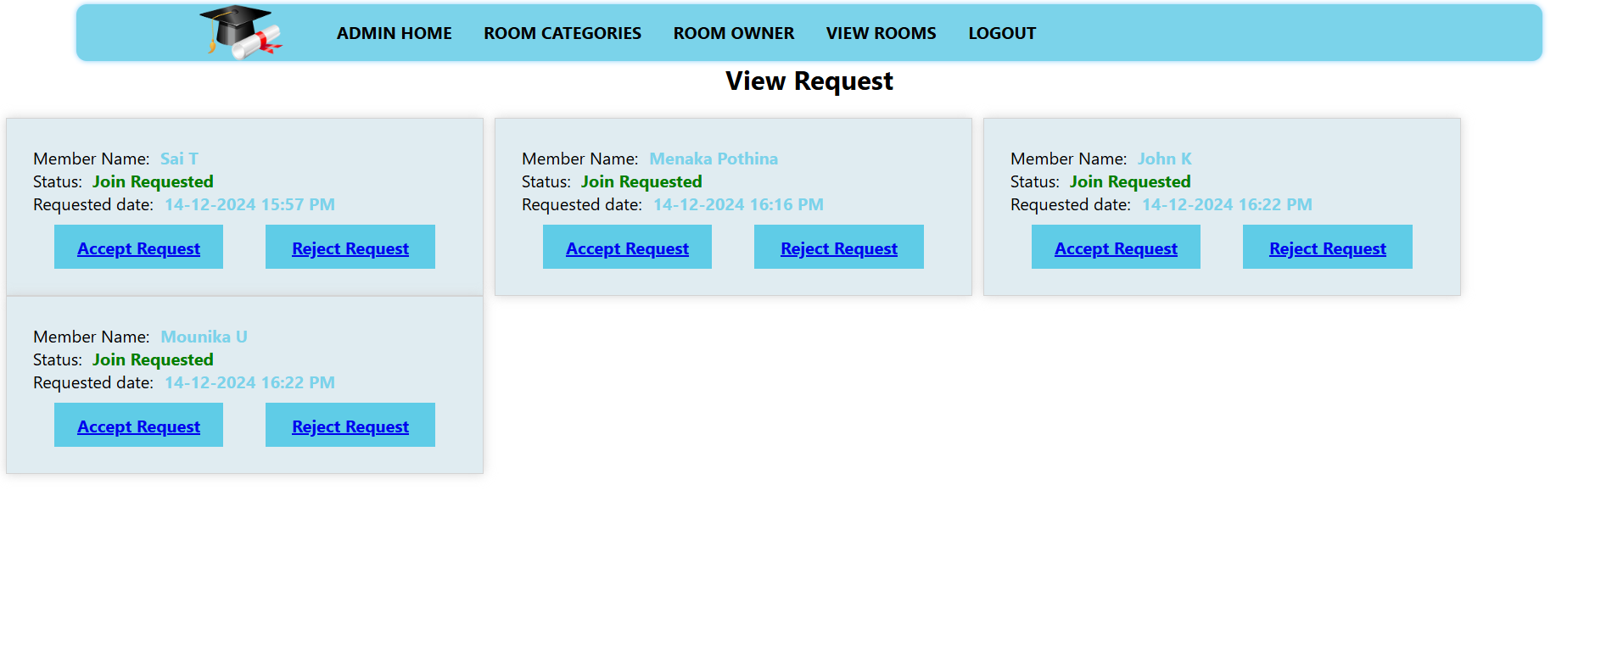
View accept and reject requests

Slide 22
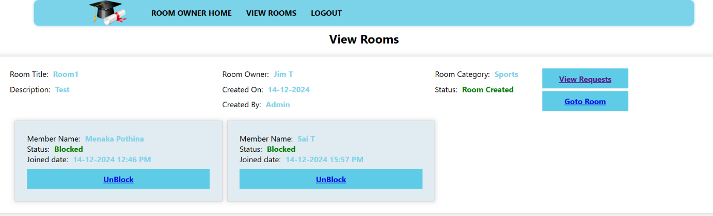
View rooms

Slide 23
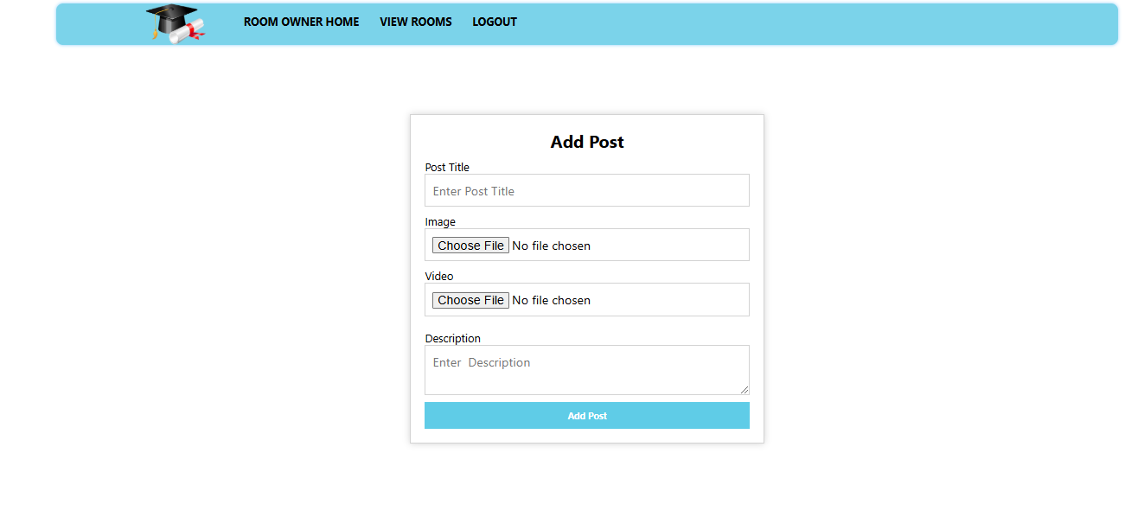
Add post details

Slide 24
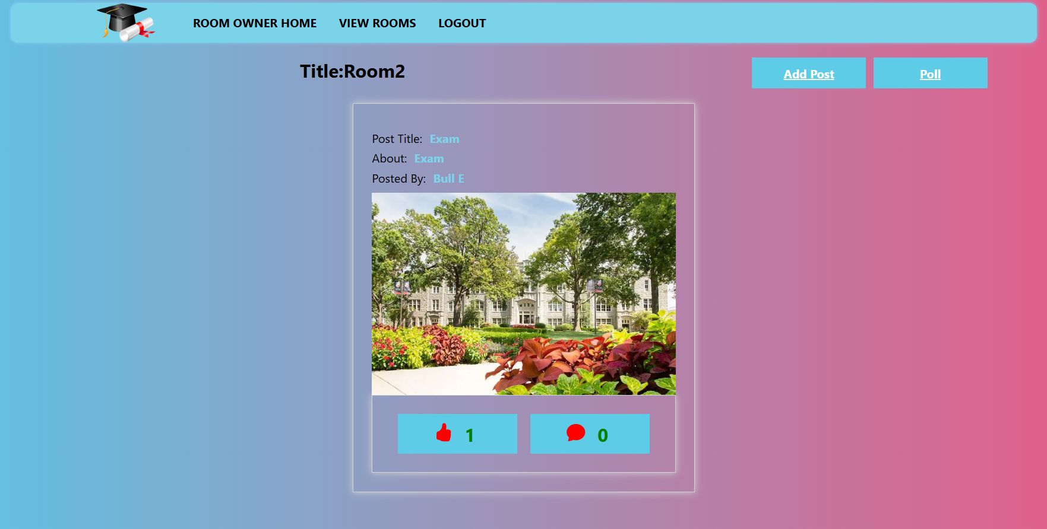
Add and view rooms
.

Slide 25
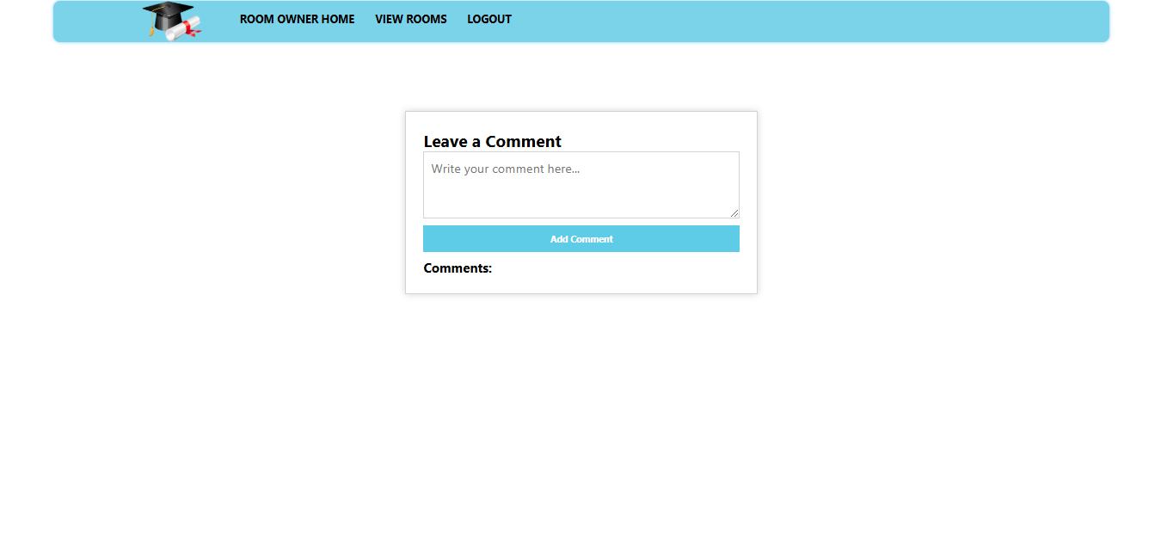
Rise comment

Slide 26
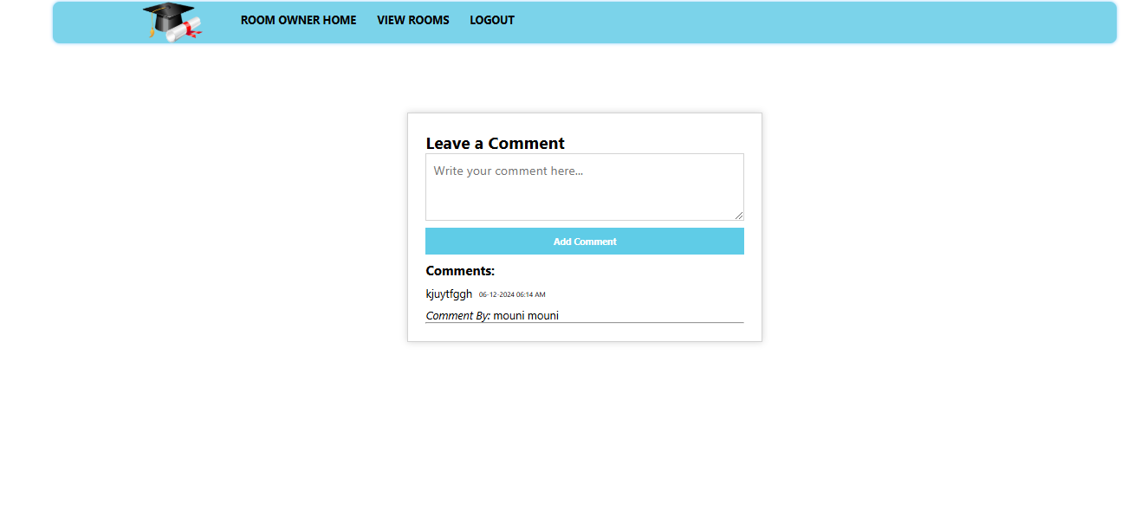
Leave comment

Slide 27
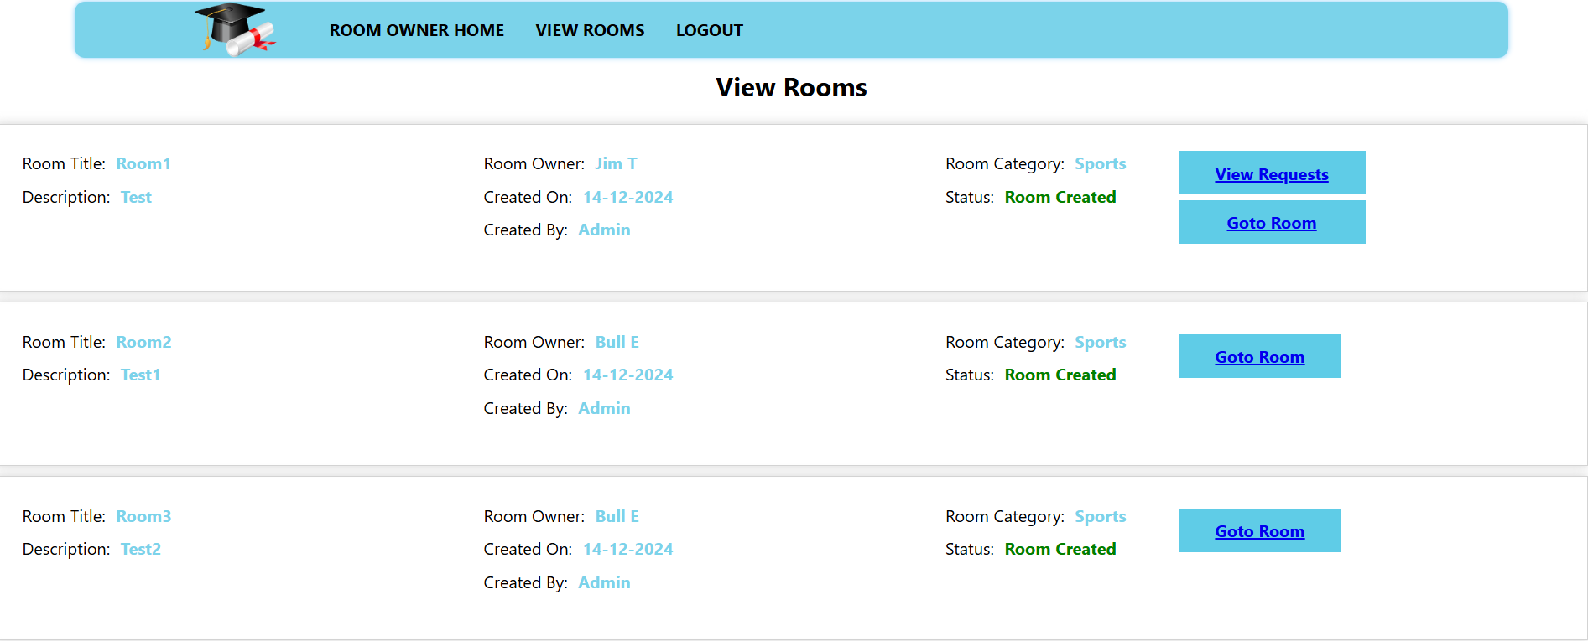
View room details

Slide 28
View rooms
.

Slide 29
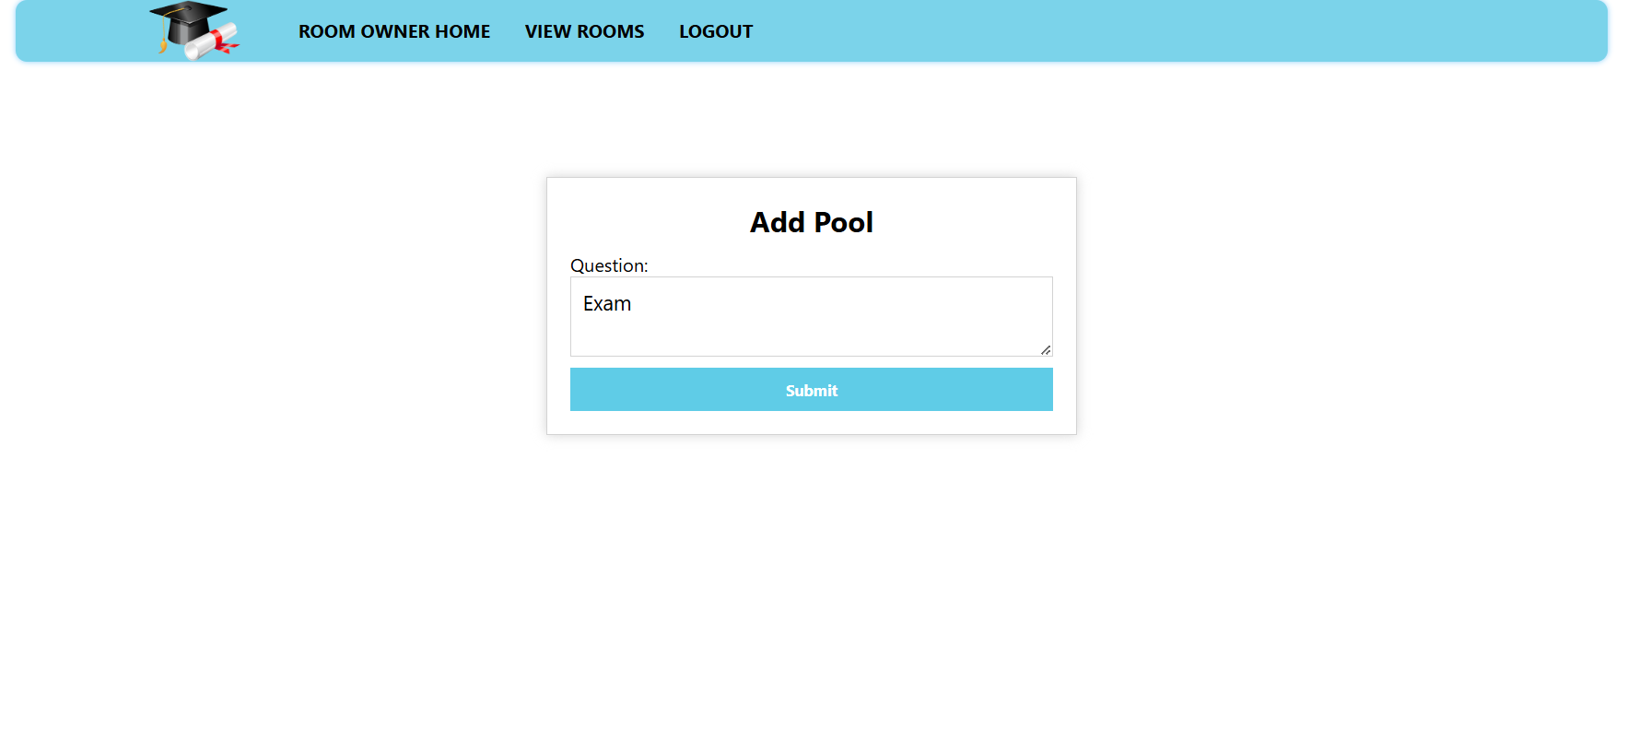
Add polls

Slide 30
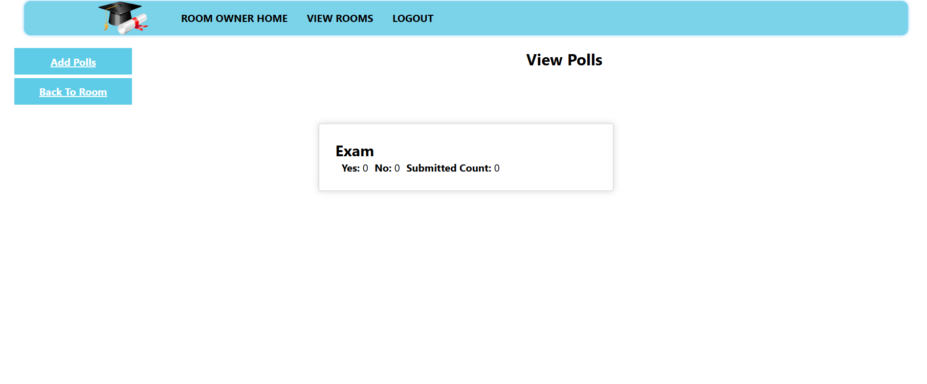
Admin to view polls

Slide 31
Admin to view member requests

Slide 32
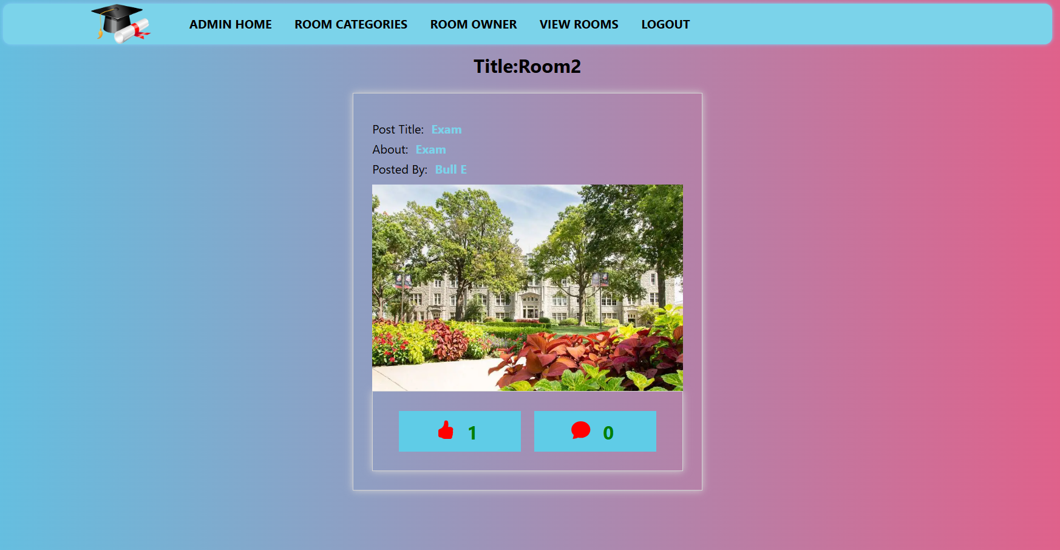
Admin to view rooms
.

Slide 33

Thank you

